Slide 1
Google Classroom
Students log in 2020

Slide 2
Click log in then click student portal

Slide 3
Type your user ID: e.g. amie.foscholo2 enter your password: e.g. 1f

Slide 4
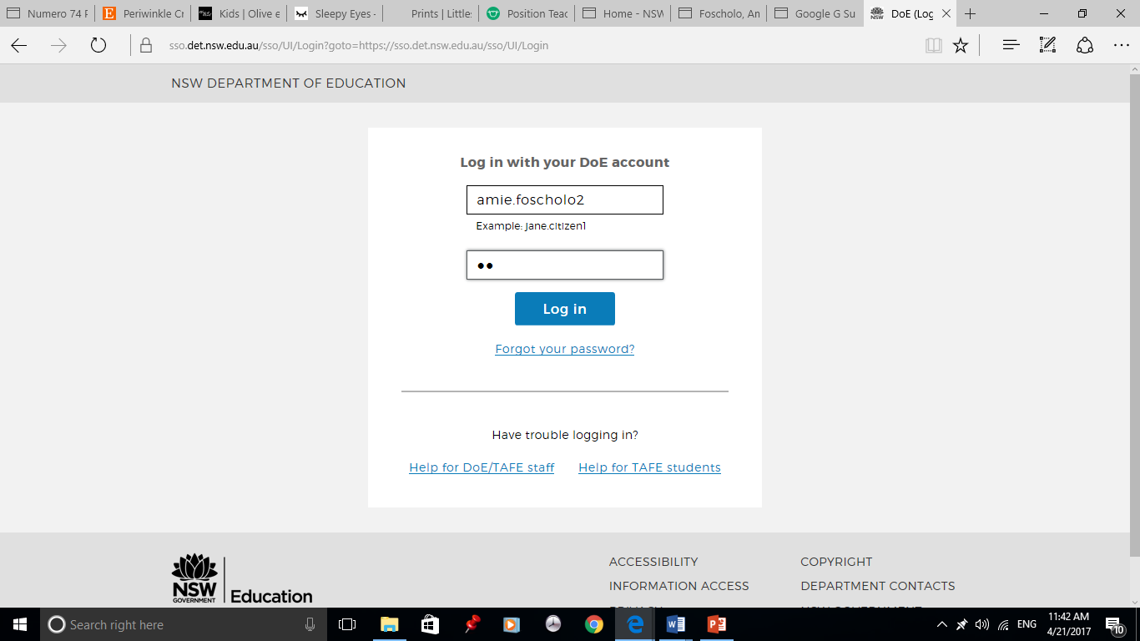

Slide 5
Once you have successfully logged in you will then be lead to kidspace. Click ‘agree’

Slide 6
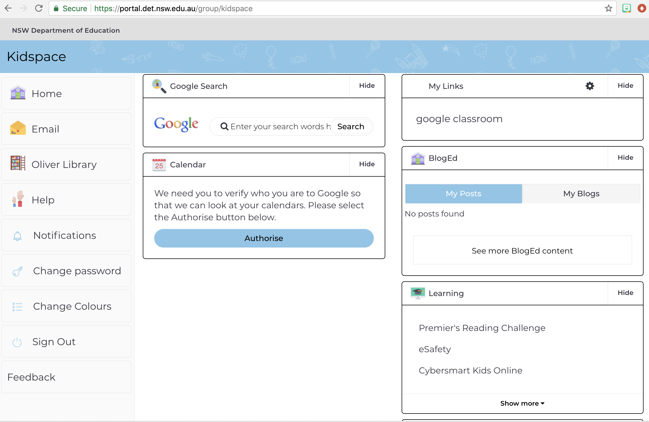
Click show more

Slide 7
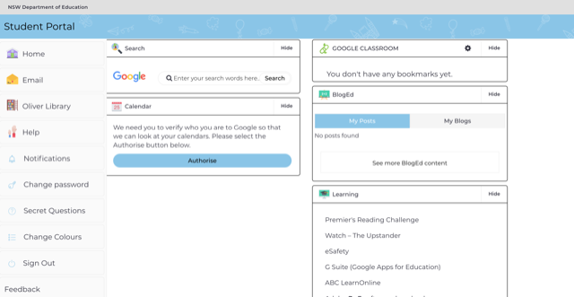
Click G suite

Slide 8
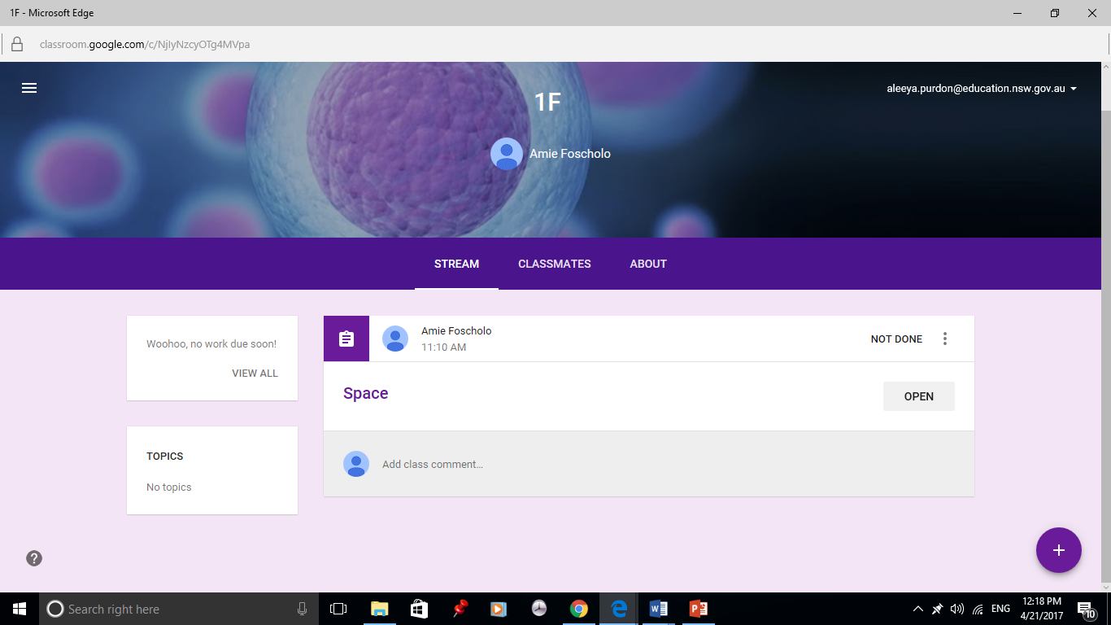
If your teacher has assigned any work for you it will be listed under stream Click ‘Open’ to access the assigned work.

